Slide 1
Repetition

Slide 2
Content Overview
Repetition (looping) Control Structures
The while-do loop
  Sentinel-controlled structures
  Count-controlled structures
  Flag-controlled structures
break and continue statements
The for loop
The do-while loop
A use for comma expressions
Variable Scope

Slide 3
Why Do We Need Repetition?
Sometimes the same set of instructions must be executed several times.
Retyping the same set of instructions in a program is impractical and we would always need to know the exact number of times the set of instructions was to be repeated.
For these reasons we need repetition control structures.

Slide 4
Why Do We Need Repetition?
For example, we can add five numbers together by:
  declaring a variable for each number, inputting the numbers and adding the variables together

Slide 5
Why Do We Need Repetition?
#include <iostream>
using namespace std;
int main()
{
int num1, num2, num3, num4, num5, sum;
cin >> num1 >> num2 >> num3 >> num4 >> num5;
sum = num1 + num2 + num3 + num4 + num5;
cout << "sum = " << sum << endl;
return 0;
}

Slide 6
Why Do We Need Repetition?
A much better alternative is:
To construct a repetition structure that reads a number into a variable and adds it to the variable that contains the sum of the numbers and repeat this procedure until all numbers are read
    int num, sum = 0;
    cin >> num;
    sum = sum + num;
  Repeat statements
  2 and 3 for each number

Slide 7
Why Do We Need Repetition?
BEGIN add 5 numbers together
sum = 0
REPEAT 5 times
INPUT a_number
sum = sum + a_number
ENDREPEAT
PRINT sum
END add 5 numbers together

Slide 8
Why Do We Need Repetition?
An example of pseudocode to determine and print out which of N numbers is the largest:
BEGIN print the largest of N numbers
INPUT a_number
largest_number = a_number
REPEAT until there are no more numbers left
INPUT a_number
IF a_number is larger than largest_number THEN
largest_number = a_number
ENDIF
ENDREPEAT
PRINT largest_number
END print the largest of N numbers

Slide 9
C++ Repetition Statements
C++ has three repetition structures
  while loop
  for loop
  do-while loop

Slide 10
The while-do Loop
The general form of the while-do statement is:
while is a reserved word
The statement can be simple or compound
The expression acts as a decision maker and is a logical expression
The statement is called the body of the loop
while(expression)
statement

Slide 11
The while-do Loop Flowchart
Previous Statement
A guarded loop
loop guard
No
Is condition
true?
Yes
Statement or block of code
Next Statement

Slide 12

The Guarded while-do Loop
#include <iostream>
using namespace std;
int main()
{
int sum = 0;
while (sum <= 10)
{
sum = sum + 2;
cout << sum << " ";
}
return 0;
}
What is the output of this program?
ANSWER: 2 4 6 8 10 12

Slide 13
The Guarded while-do Loop
The loop guard (condition) is tested first to see whether one execution of the loop’s statement should be allowed.
If the condition is true the statements in the body of the loop are executed, control is passed back to the start of the loop and the test carried out again.

Slide 14
The Guarded while-do Loop
If the condition is false, then the statements in the body of the loop are not executed.
This guarded loop is also known as
a sentinel-controlled while loop

Slide 15
Sentinels
In computer programming, data values used to signal either the start or end of a data series are called sentinels.
The sentinel value must be selected so that it will not conflict with legitimate data values.

Slide 16
‘Print the Largest Number ’Revisited
#include <iostream>
using namespace std;
int main()
{
int num, largest;
cout <<"Enter numbers "
<<"ending with -1: ";
cin >> num;
largest = num;
while (num != -1)
{
cin >> num;
if (num > largest)
largest = num;
}
cout << largest;
return 0;
}
BEGIN print the largest of N numbers
INPUT a_number
largest_number = a_number
REPEAT until there are no more numbers left
INPUT a_number
IF a_number is larger than largest_number THEN
largest_number = a_number
ENDIF
ENDREPEAT
PRINT largest_number
END print the largest of N numbers
Using a
sentinel-controlled while loop

Slide 17
A better version
#include <iostream>
using namespace std;
int main()
{
int num, largest=-1;
cout <<"Enter numbers "
<<"ending with -1: ";
cin >> num;
while (num != -1)
{
if(num > largest)
largest = num;
cin >> num;
}
cout << largest;
return 0;
}
BEGIN print the largest of N numbers
INPUT a_number
largest_number = a_number
REPEAT until there are no more numbers left
INPUT a_number
IF a_number is larger than largest_number THEN
largest_number = a_number
ENDIF
ENDREPEAT
PRINT largest_number
END print the largest of N numbers
This code is better because the sentinel is never compared with the number

Slide 18

The Average of N Positive Numbers
#include <iostream>
using namespace std;
int main()
{
int num, count=0, sum=0;
cout <<"Enter numbers "
<<"ending with -999: ";
cin >> num;
while (num != -999)
{
sum += num;
count++;
cin >> num;
}
cout << sum/count;
return 0;
}
BEGIN average of N positive numbers
count = 0;
sum = 0;
INPUT a_number
REPEAT until number is -999
sum = sum + a_number
count = count + 1
INPUT a_number
ENDREPEAT
PRINT sum/count
END average of N positive numbers
LOOK!
correct use of the sentinel

Slide 19
The Average of N Positive Numbers
#include <iostream>
using namespace std;
int main()
{
int num, count=0, sum=0;
cout <<"Enter numbers "
<<"ending with -999: ";
cin >> num;
while (num != -999)
{
sum += num;
count++;
cin >> num;
}
cout << sum/count;
return 0;
}
BEGIN average of N positive numbers
count = 0;
sum = 0;
INPUT a_number
REPEAT until number is -999
sum = sum + a_number
count = count + 1
INPUT a_number
ENDREPEAT
PRINT sum/count
END average of N positive numbers
BUT
Wrong answer!
Integer division

Slide 20
The Guarded while-do Loop
Another type of guarded while loop is the counter-controlled while loop.
If we know exactly how many times the loop must be executed, the while loop might look like this:
while (counter < 50)
{
. . .
counter++;
. . .
}

Slide 21
A Guarded while-do Loop Example
while (counter < limit)
{
cin >> number;
sum = sum + number;
counter++;
}
Note that variables counter, limit and sum must be previously declared and initialised.

Slide 22
The Guarded while-do Loop
Note also that:
  If initial the condition is false, the loop’s statement is never executed.
  One thing that must be provided in the body of the loop is a possibility for the guard condition to be changed.
  If the guard condition is not changed the loop never terminates (infinite loop).

Slide 23
Example
#include <iostream>
using namespace std;
int main()
{
int num = 1;
while(num <= 10)
{
cout << num << " " ;
num = num * 2;
}
return 0;
}
must initialise num
Without this it will loop forever
num gets to 16 here
Output:
1 2 4 8

Slide 24
Example
#include <iostream>
using namespace std;
int main()
{
int count = 1;
while(count <= 7)
{
cout << count << " ";
count++;
}
return 0;
}
What is the output of this program?
Answer:
1 2 3 4 5 6 7

Slide 25
Example
#include <iostream>
using namespace std;
int main()
{
int count = 1;
while(count <= 7)
{
cout << count << " ";
count++;
}
return 0;
}
Can you improve this program?

Slide 26
Example
#include <iostream>
using namespace std;
int main()
{
int count = 1;
while(count <= 7)
{
cout << count++ << " ";
}
return 0;
}
What is the output of this program?
Answer:
1 2 3 4 5 6 7

Slide 27
Example
What is the output of this program if I enter
1 2 3 -1?
#include <iostream>
using namespace std;
int main()
{
int totalMarks = 0, marks = 0;
while(marks >= 0)
{
cout << "Enter a mark (-1 to end): ";
cin >> marks;
totalMarks += (marks >= 0 ? marks : 0);
}
cout << "Total Marks: " << totalMarks
<< endl;
return 0;
}
Answer:
Total Marks: 6

Slide 28

Example
This is not a good program.
Let's do better.
#include <iostream>
using namespace std;
int main()
{
int totalMarks = 0, marks = 0;
while(marks >= 0)
{
cout << "Enter a mark (-1 to end): ";
cin >> marks;
totalMarks += (marks >= 0 ? marks : 0);
}
cout << "Total Marks: " << totalMarks
<< endl;
return 0;
}

Slide 29
Example
#include <iostream>
using namespace std;
int main()
{
int num, result = 1;
cout << "Enter a number: ";
cin >> num;
while(num > 0)
{
result = result * num--;
}
cout << "result is: " << result
<< endl;
return 0;
}
What is the output of this program if I enter 4?
Answer:
result is 24

Slide 30

Example
No!!!
BIG MISTAKE
result is multiplied by 0
#include <iostream>
using namespace std;
int main()
{
int num, result = 1;
cout << "Enter a number: ";
cin >> num;
while(num > 0)
{
result = result * --num;
}
cout << "result is: " << result
<< endl;
return 0;
}
What is the output of this program if I enter 4?
Answer:
result is 0

Slide 31
The Guarded while-do Loop
Another type of guarded while loop is the flag-controlled while loop.
It uses a Boolean variable to control the while loop. The loop might look like this:
while (!found)
{
. . .
if(expression)
found = true;
. . .
}
This variable is called a flag variable

Slide 32
Example (revisited)
What happens if by mistake I put a ; here?
#include <iostream>
using namespace std;
int main()
{
int num = 1;
while(num <= 10)
{
cout << "num = " << num
<< " " ;
num = num * 2;
}
return 0;
}

Slide 33
Example (revisited)
#include <iostream>
using namespace std;
int main()
{
int num = 1;
while(num <= 10);
{
cout << "num = " << num
<< " " ;
num = num * 2;
}
return 0;
}
No output produced,
the program hangs…

Slide 34
while-do Statement Summary
The while-do statement is a pre-test loop; the loop guard is tested first.
It uses an expression to control the loop.
No semicolon is required at the end of the while-do statement.
If we want to include multiple statements in the body, we must put them in a compound statement.

Slide 35
Example (revisited again)
#include <iostream>
using namespace std;
int main()
{
int num = 1;
while(num <= 10)
cout << num << " " ;
num = num * 2;
return 0;
}
What is the output of this program?

Slide 36
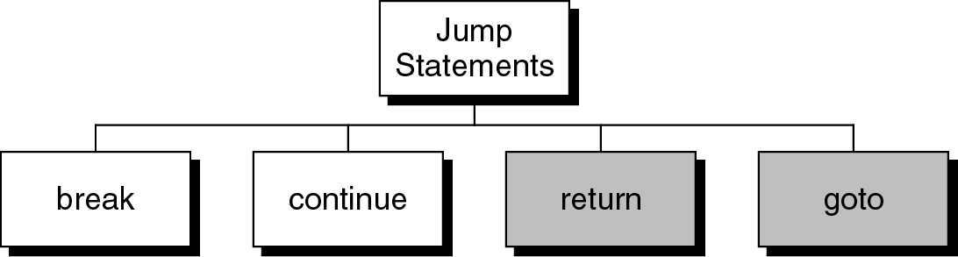
Jump Statements
Jump Statements allow the flow of the program to “jump” from its normal flow.

Slide 37
Jump Statements
We will discuss the return statement later when we discuss functions.
The goto statement is UNSUITABLE for structured programs. Therefore, we won’t even discuss it here.

Slide 38
break Statement
We used the break statement inside the switch statement.
The break statement can also be used to terminate a loop – but should not be.
In a series of nested loops, break only terminates the inner loop - the one the program is currently in.
The break statement needs a semicolon.

Slide 39
break Statement
while(condition)
{
...
break;
...
}
next statement

Slide 40
Example using break
#include <iostream>
using namespace std;
int main()
{
int totalMarks = 0, marks = 0;
while (true)
{
cout << "Enter a mark (-1 to end): ";
cin >> marks;
if (marks < 0)
break;
totalMarks += marks;
}
cout << "Total Marks: " << totalMarks << endl;
return 0;
}
The loop terminates when marks < 0. That’s the purpose of break

Slide 41
Example using break
Using break is NOT a good structured programming style.
You can always rewrite your code WITHOUT the break statement.
NEVER USE break to exit a loop in this subject!!!

Slide 42
Using break – Rules of Thumb
Limit the use of break to switch statements.
Although break statements are valid in all loop structures, it is not regarded as good structured programming style.
Instead of using break statements inside loops, try to redesign your program.

Slide 43
continue Statement
The continue statement does not terminate the loop, but it transfers execution to the testing expression.
In a pre-test loop, it is similar to a jump to the beginning of the loop.
The continue statement is also considered to be unstructured programming.
Try to avoid using it at all.

Slide 44
Example using continue
#include <iostream>
using namespace std;
int main()
{
int totalEven = 0, number = 0;
while (number >= 0)
{
cout << "Number (-1 to exit) = ";
cin >> number;
if (number % 2 != 0)
continue;
totalEven += number;
}
cout << "Total Even Numbers = " << totalEven << endl;
return 0;
}

Slide 45
Example
//While loop with break *** IN THIS SUBJECT NEVER USE BREAK INSIDE A LOOP ***
#include <iostream>
using namespace std;
int main()
{
int num, sum;
sum = 0;
cout << "Enter numbers: ";
cin >> num;
while (cin)
{
if (num < 0) //if number is negative, terminate the loop
{
cout << "Negative number found in the data" << endl;
break;
}
sum = sum + num;
cin >> num;
}
cout << endl;
cout << "The sum is: " << sum << endl;
return 0;
}
What's this ?
This is not logical.

Slide 46
Example
//While loop with break *** IN THIS SUBJECT NEVER USE BREAK INSIDE A LOOP ***
#include <iostream>
using namespace std;
int main()
{
int num, sum;
sum = 0;
cout << "Enter numbers: ";
cin >> num;
while (!cin.eof())
{
if (num < 0) //if number is negative, terminate the loop
{
cout << "Negative number found in the data" << endl;
break;
}
sum = sum + num;
cin >> num;
}
cout << endl;
cout << "The sum is: " << sum << endl;
return 0;
}

Slide 47
Example
//While loop with break *** IN THIS SUBJECT NEVER USE BREAK INSIDE A LOOP ***
#include <iostream>
using namespace std;
int main()
{
int num, sum;
sum = 0;
cout << "Enter numbers: ";
cin >> num;
while (!cin.eof() && num >=0)
{
sum = sum + num;
cin >> num;
}
if (num < 0) //if number is negative, loop terminated
cout << "Negative number found in the data" << endl;
cout << endl;
cout << "The sum is: " << sum << endl;
return 0;
}

Slide 48
The for Loop
The for loop is a pre-test loop that uses three expressions: the initialisation expression, the conditional expression and the updating expression
The format of the for statement is
for(init_expr; test_expr; update_expr)
statement;

Slide 49
The for Loop
This loop structure
for(init_expr; test_expr; update_expr)
statement;
is equivalent to
init_expr;
while(test_expr)
{
statement;
update_expr;
}

Slide 50
The for Loop
Thus the init_expr is executed when the for loop starts and then the test_expr is evaluated.
If the test_expr is non-zero the statement is executed followed by the update_expr
(executed at the end of each loop).
The test_expr is evaluated before every loop starts.

Slide 51
Example
#include <iostream>
using namespace std;
int main()
{
int count;
for (count = 0; count < 10; count++)
cout << count << " ";
return 0;
}

Slide 52
Output of Example 5
0 1 2 3 4 5 6 7 8 9
Hey, I can create this easily with a while statement!

Slide 53
Creating the code with while
#include <iostream>
using namespace std;
int main()
{
int count=0;
while (count < 10)
{
cout << count << " ";
count++;
}
return 0;
}
Here it is....
Piece of cake!

Slide 54
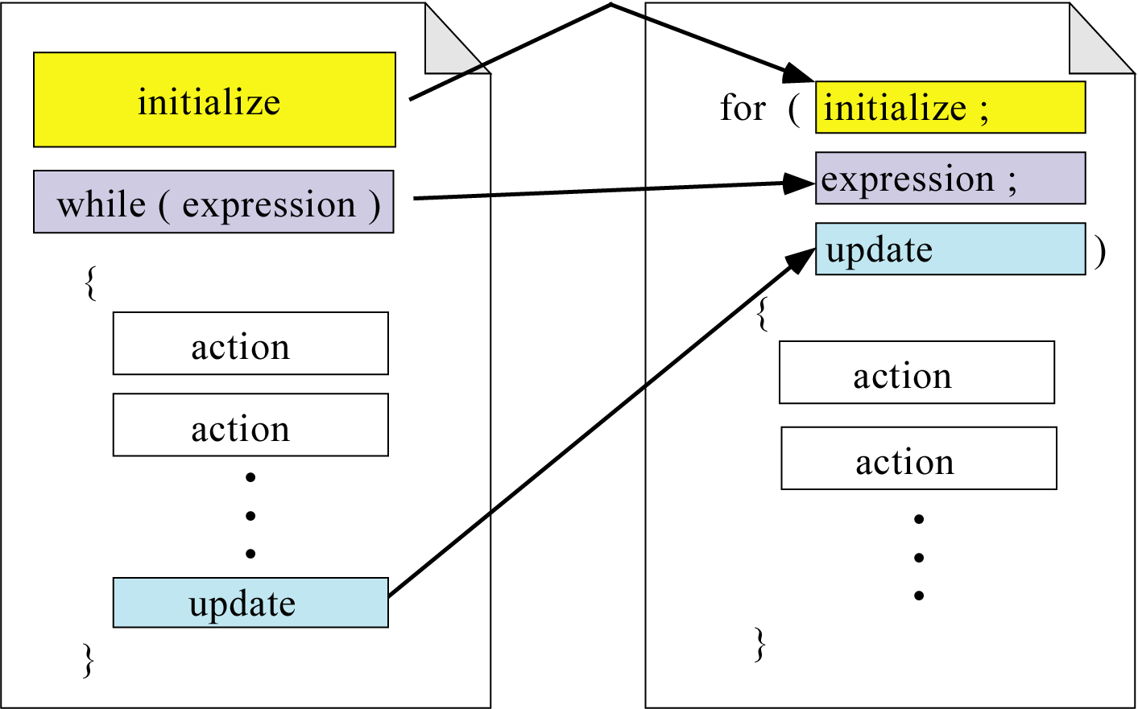
Representing for with while

Slide 55
Example: Printing Even Numbers
#include <iostream>
using namespace std;
int main()
{
int count;
for (count = 0; count < 10; count += 2)
cout << count << " ";
return 0;
}
for loops should always contain an
index variable
0 2 4 6 8

Slide 56
Example: Summing 20 Numbers
int i = 1; int i, num;
int num; int sum = 0;
int sum = 0; for(i=1; i<=20; i++)
while (i<=20) {
{ cin >> num;
cin >> num; sum += num;
sum += num; }
i++;
}

Slide 57
Example: Summing 20 Numbers
LOOK! index variable i can also be declared here
int num;
int sum = 0;
for(int i=1; i<=20; i++)
{
cin >> num;
sum += num;
}

Slide 58
Example: A more likely C++ solution
int num;
int sum=0;
for (int i=0; i<20; i++)
{
cin >> num;
sum += num;
}
Counting from 0 is much more common in C++

Slide 59
The do-while Loop
int num;
int i = 0, sum=0;
do
{
cin >> num;
sum += num;
i++;
} while (i<20);

Slide 60
Notes on the do-while Loop
Note that the do-while ends with a semicolon. This is different to the other loops.
We use this loop when we want the body of the loop to be executed at least once.
A common application is when it is used for data validation.

Slide 61
What’s wrong with this program?
#include <iostream>
using namespace std;
int main()
{
int num, sum;
num = sum = 0;
cout << "Number (-1 to end):";
cin >> num;
do
{
sum += num;
cout << "Number (-1 to end):";
cin >> num;
} while (num >= 0);
cout << "Sum= " << sum << endl;
return 0;
}
Data consisting of just the sentinel is processed

Slide 62
Example: Data Validation
do
{
cout << "Enter an identification number: ";
cin >> idNum;
} while (idNum < 1000 || idNum > 1999);
The do-while loop is useful when it does not make sense to check a condition until after the action occurs.

Slide 63
The for Loop (again)
As we discussed earlier:
The init_expr is evaluated when the for loop starts and the test_expr is evaluated.
If the test_expr is non-zero the statement is executed followed by the update_expr
(executed at the end of each loop)
The test_expr is evaluated before every loop.

Slide 64
Example
#include <iostream>
using namespace std;
int main()
{
int count;
for (count = 0; count < 10; count++)
cout << count << " ";
return 0;
}
0 1 2 3 4 5 6 7 8 9

Slide 65
Notes on the expressions
C++ allows the initialisation expression (init_expr) to be empty.
C++ also allows the loop control expression (test_expr) to be controlled inside the body of the for statement itself.
The updating expression (update_expr) can be null and the updating can also be done inside the body of the for statement.
None of this is recommended!

Slide 66
What does it mean?
init_expr, test_expr and update_expr can be empty. What does it mean?
Let’s see an example for each case

Slide 67
Example: init_expr is omitted
#include <iostream>
using namespace std;
int main()
{
int count=0;
for (; count < 10; count += 2)
cout << count << " ";
return 0;
}
The init_expr can be omitted because count has been set to 0 in the initialisation statement

Slide 68
Example: update_expr is omitted
#include <iostream>
using namespace std;
int main()
{
int count=0;
for (; count < 10;)
{
cout << count << " ";
count += 2;
}
return 0;
}
update_expr is omitted and it is moved to the body of the loop

Slide 69
Example: test_expr is omitted
If test_expr is omitted, then the condition is always true. It’s the same with while(true), the loop will never terminate unless, we use break. This is NOT a good practice!
#include <iostream>
using namespace std;
int main()
{
int count=0;
for (;;)
{
if (count == 10) break;
cout << count << " ";
count += 2;
}
return 0;
}

Slide 70
So what's the point of a for loop ?
Use only when you want to count.
Do not leave out any of the three components
  - use a while if you want to do that
Never change the index variable within the loop.
The reader should be able to look at the for loop's header and determine how many times the loop will execute.
No break.

Slide 71
Example: The comma (,) operator
Consider the following program:
#include <iostream>
using namespace std;
int main()
{
int count;
for (count = 0; count < 10; count += 2)
cout << count << " ";
return 0;
}
How many times does the test get performed?

Slide 72
Example: The comma (,) operator
#include <iostream>
using namespace std;
int main()
{
int count, ttimes = 0;
for (count = 0; ttimes++, count < 10; count += 2);
cout << count << " ";
cout << "Tested " << ttimes << " times\n";
return 0;
}
Note that this is only ONE expression!

Slide 73
The comma operator
In general, using operator comma (,) is also not good practice.
Although, it might not be good style, sometimes you will see code that uses this style, and you should understand it.
But do not use it yourself.

Slide 74
The comma expression
A comma expression is a complex expression made up of two or more expressions separated by commas.
It is generally used in for statements and in declaration statements.

Slide 75
The comma expression
The expressions are evaluated from left to right and the comma has the lowest precedence of all operators.
The value and type of the expression is that of the right hand side expression.

Slide 76
Example
for (sum = 0, i = 1; i <= 20; i++)
{
cin >> a;
}
is equivalent to:
sum = 0;
for (i = 1; i <= 20; i++)
{
cin >> a;
}

Slide 77
Example: while-do and do-while
while loop: 12345678910
Loop Count: 11
Number of tests: 11
#include <iostream>
using namespace std;
int main
{
int loopCount=1, testCount=0;
cout << "while loop: ";
while (testCount++, loopCount <= 10)
cout << loopCount++;
cout << "\nLoop Count: " << loopCount << endl;
cout << "Number of tests: " << testCount
<< endl;
return 0;
}

Slide 78
Example: while-do and do-while
do..while: 12345678910
Loop Count: 11
Number of tests: 10
#include <iostream>
using namespace std;
int main
{
int loopCount=1, testCount=0;
cout << "do..while: ";
do
cout << loopCount++;
while (testCount++, loopCount <= 10)
cout << "\nLoop Count: " << loopCount << endl;
cout << "Number of tests: " << testCount
<< endl;
return 0;
}

Slide 79
Notes on Example
Both the while and the do-while loops contain a comma expression.
Because the value of the whole comma expression is the value of the last expression, the limit test expression (in this example loopCount <= 10 ) must be coded last.

Slide 80
Notes on Example
Both the loops count from one to ten, but the loop expression was tested 11 times in the while loop and only 10 times in the do…while loop.
In a pre-test loop, the test is done n + 1 times.
In a post-test loop, the test is done n times.

Slide 81
Nested Loops
In many situations, it is convenient to use a loop contained within another loop.
Such loops are called nested loops.

Slide 82
Example
#include <iostream>
using namespace std;
int main()
{
int i, j;
for (i=0; i < 3; i++)
for (j=3; j >= 0; j--)
cout << i << ", " << j << endl;
return 0;
}
0, 3
0, 2
0, 1
0, 0
1, 3
1, 2
1, 1
1, 0
2, 3
2, 2
2, 1
2, 0

Slide 83
Variable Scope
A variable that is defined in a loop is only valid in the loop’s scope. This variable is not known outside that scope.
This example has two possible outcomes.
If i is not defined before the loop, this generates a compiler error, because the variable i is unknown the loop.
for (int i=0; i < 5; i++)
cout << i << endl;
cout << i;

Slide 84
Variable Scope
A variable that is defined in a loop is only valid in the loop’s scope. This variable is not known outside that scope.
This example has two possible outcomes.
If i has been defined before the loop, the value printed is the value of i as it was before the loop.
for (int i=0; i < 5; i++)
cout << i << endl;
cout << i;

Slide 85
Write a C++ Program
An integer is divisible by 9 if the sum of its digits is divisible by 9.
Write a program that prompts the user to input an integer.
The program should then output the number and a message stating whether the number is divisible by 9.
(*** cannot use % ***)

Slide 86
Develop a C++ Program
Design a program that prints five spreadsheet-style column titles with the values A, B, C, D, and E, and five row titles with the values 1, 2, 3, 4, 5. Use a for loop to output the column headings. Use nested for loops to output the row number and the values within the rows and columns. The output should look like the following.
A B C D E
1 1 2 3 4 5
2 1 2 3 4 5
3 1 2 3 4 5
4 1 2 3 4 5
5 1 2 3 4 5

Slide 87
Program Design
Write a for loop to output the letters A through E with a tab before each letter.
Begin a for loop to output 5 rows
Output the number of the row
Begin a for loop to output 5 columns
0utput the numbers 1 through 5 with a
tab before each number
End the inner loop
Output a newline
End the outer loop

Slide 88
Program Code
#include <iostream>
using namespace std;
int main ()
{
for (char title = 'A'; title < 'F'; title++)
cout << '\t' << title;
cout << endl;
for (int outer = 1; outer < 6; outer++)
{
cout << outer;
for (int inner = 1; inner < 6; inner++)
cout << '\t' << inner;
cout << endl;
}
return 0;
}

